Slide 1

Space Exploration Report Analysis
An Exploratory Data Analysis Project

Slide 2

Data Collection and Understanding
Assessing the scope and quality of the space mission dataset.

Slide 3
Dataset Overview
Scope: Analysis of over 10,000 historical and planned space missions.
Key Numerics: 'Cost_Million_USD', 'Duration_Days', 'Success_Rate', 'Year'.
Key Categories: 'Country', 'Agency', 'Mission_Type', 'Destination', 'Mission_Status'.
Objective: To identify trends and factors influencing mission success, cost, and duration.

Slide 4
Advanced Data Processing
Preparing the raw data for statistical analysis and modeling.

Slide 5
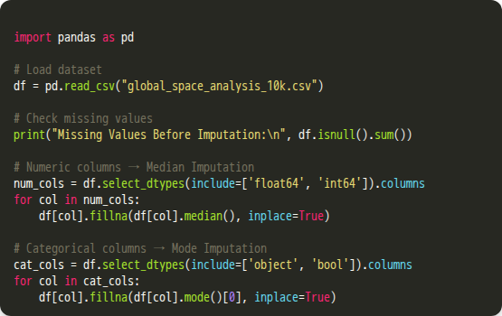
Handling Missing Data
•
Applied Median Imputation to 'Cost_Million_USD' and 'Duration_Days'.
•
Median was chosen because it's robust against the skewed nature of cost and duration data.
•
Imputed categorical columns (like 'Mission_Type' and 'Destination') with the Mode (most frequent value).
•
A final check confirmed zero remaining null values after imputation.

Slide 6
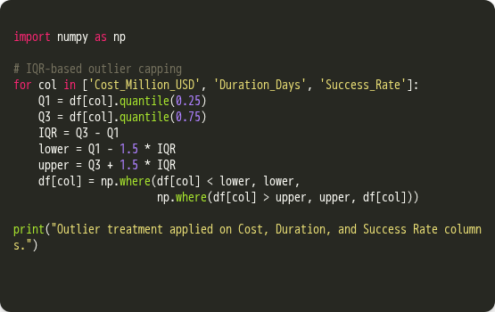
Outlier Treatment
•
Addressed extreme outliers in 'Cost_Million_USD' using the Interquartile Range (IQR) method.
•
This technique, also known as Winsorization, caps extreme values at a sensible threshold.
•
Values were capped at the Lower and Upper Bounds (Q1 ± 1.5 × IQR ) to prevent skewing the analysis.

Slide 7
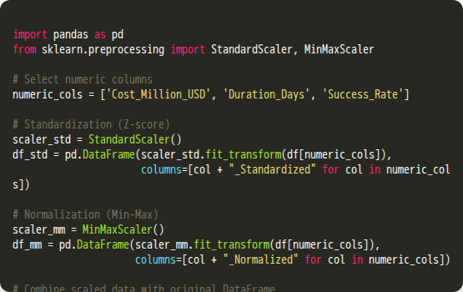
Feature Scaling
•
Standardization (Z-score): Used 'StandardScaler()' to transform data to a mean of 0 and std-dev of 1 .
•
Normalization (Min-Max): Used `MinMaxScaler()` to scale features into a fixed [ 0 , 1 ] range.
•
Purpose: This step is crucial for preparing data for distance-based algorithms (like K-Means Clustering) and gradient-descent models.

Slide 8
Exploratory Data Analysis (EDA)
Visualizing key trends, distributions, and relationships across the mission lifecycle.

Slide 9
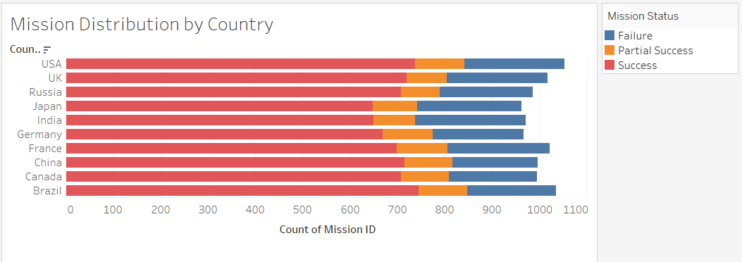
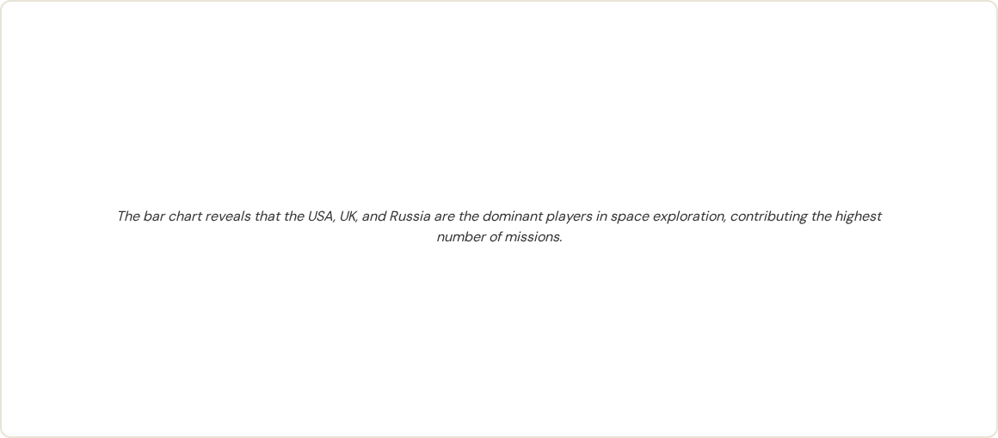
Mission Distribution by Country

Slide 10
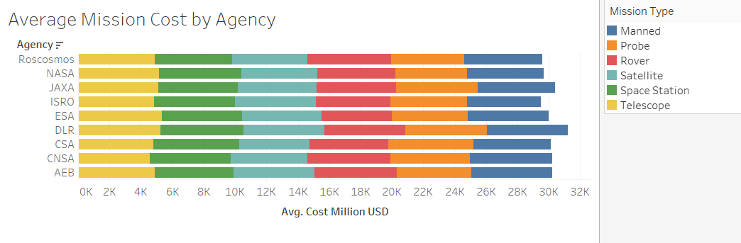
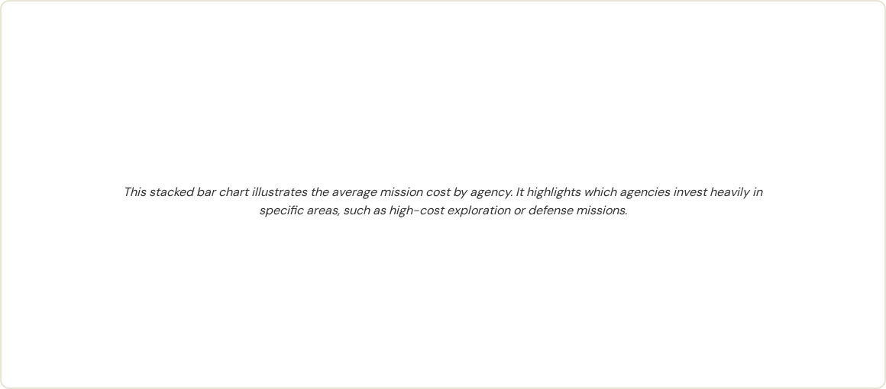
Average Mission Cost by Agency

Slide 11
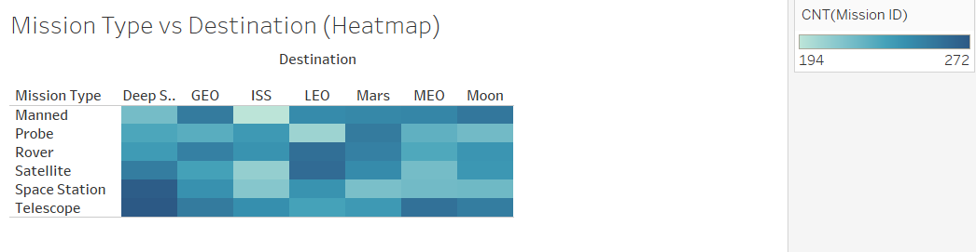
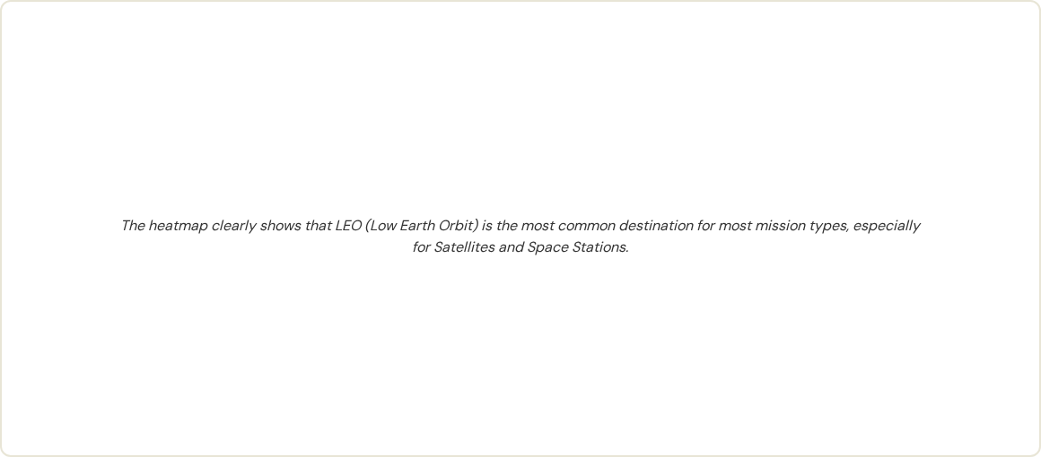
Mission Type vs Destination (Heatmap)

Slide 12
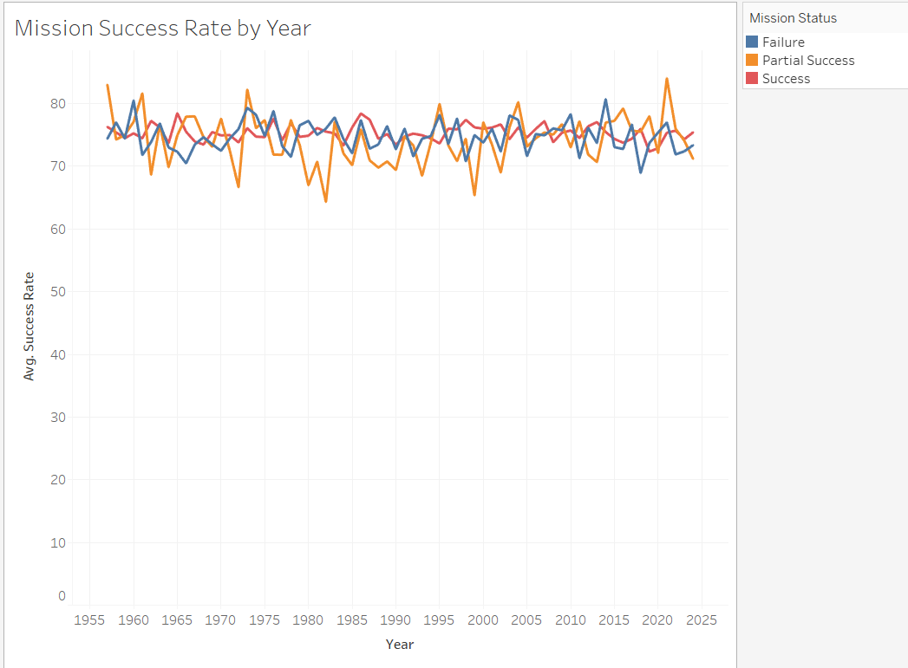

Mission Success Rate by Year

Slide 13
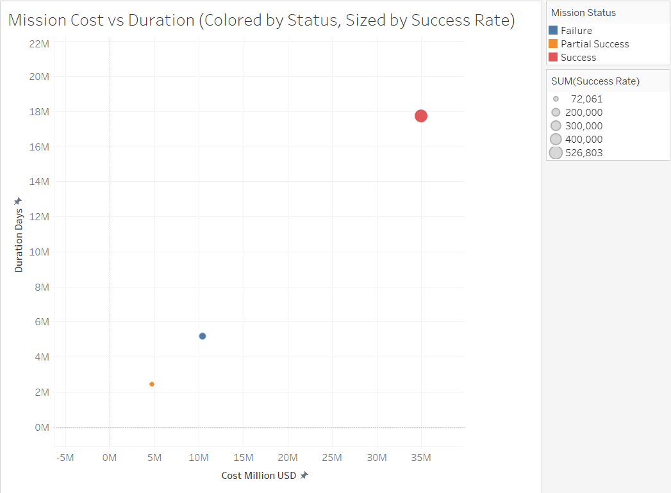
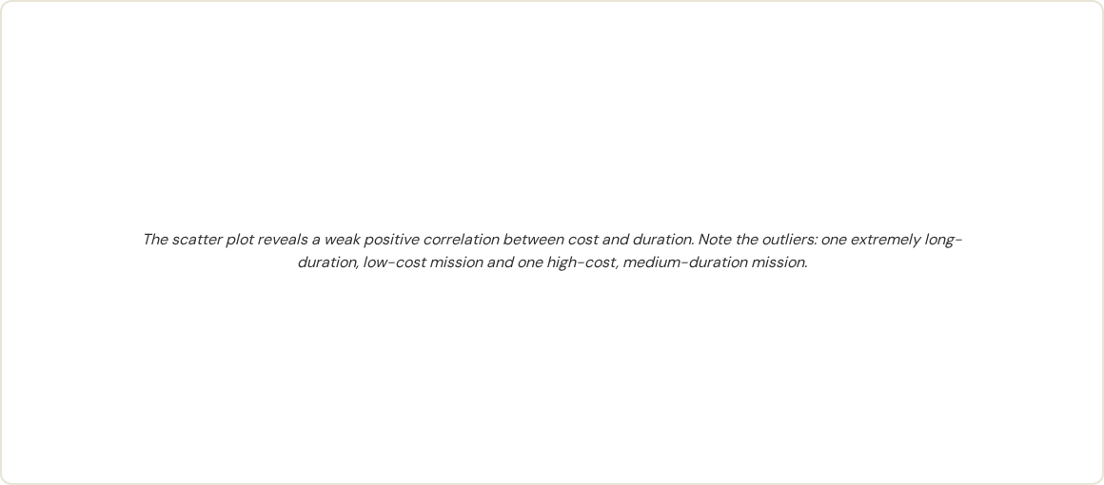
Mission Cost vs Duration

Slide 14
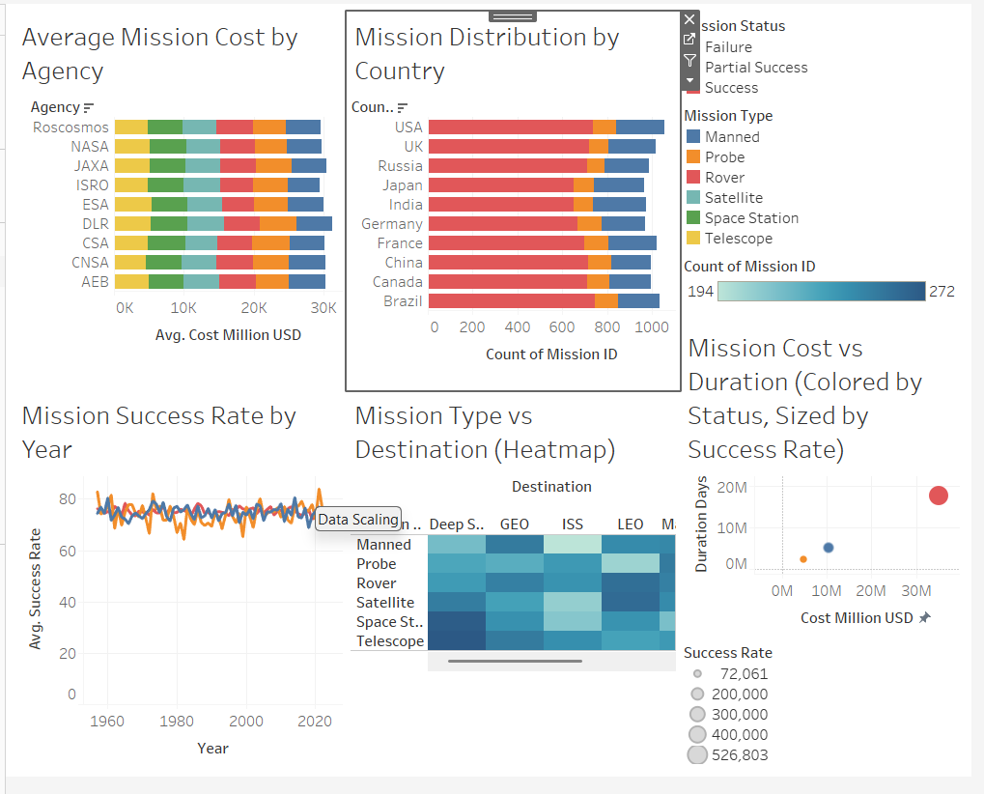
EDA Dashboard Summary

Slide 15
Questions?
Thank you for your attention.

